Slide 1

Impacts of the Michigan Merit Curriculum on Student Outcomes:
Preliminary Findings from the First Cohort

Slide 2
Academic performance among high school students in the U.S. has been largely stagnant over the past 40 years
Achievement has barely moved
High school graduation rates have not risen much
BA attainment leveling off, despite the large economic returns to college
The performance of U.S. students is mediocre in comparison to their peers in other developed countries

Slide 3
Common policies to improve high school performance
Many approaches to elementary reform
  Improve teacher training and evaluation
  Improve curriculum and pedagogy
High school reform has been more limited
  Organizational/structural (e.g., “Small Schools”)
  Career and Technical Education (CTE)
  Dropout prevention
Most common secondary reform has been to increase high school graduation requirements
  e.g., Common Core State Standards

Slide 4
Raising High School Standards Not New
1970s: Minimum competency exams of basic skills required for graduation
1980s: “New Basics” curriculum after A Nation at Risk (1983)
          Many states raise standards: 4 years of English, and 3 each of math, science and social studies
1990s: Standards-based reform leads to high school exit exams
2000s: No Child Left Behind mostly ignores high schools
          Movement for Common Core State Standards
          Promotion of AP course-taking
          College merit scholarships

Slide 5
Rationale for High Standards
Ensures students are prepared for college, and/or jobs in the 21st century economy
Provides information to students and teachers, and adds coherence to the education system
  Reduces variation that is often correlated with demographics
Spurs changes in curriculum, pedagogy, and teacher professional development

Slide 6
Concerns with High Standards
May increase dropout rates, particularly among disadvantaged students
  Reduces opportunity to take electives and CTE courses
  May increase use of alternative pathways such as the GED
Leads to unintended consequences
  Cheating
  Relabeling of courses
Requires substantial capacity on the part of teachers and schools
  MMC sharply increased demand for math/science teachers
No impact on highest-performing students because they were already fulfilling requirements before MMC

Slide 7
Past efforts to Raise Standards
High School exit exams show little promise
  Reduced HS completion among low-achieving groups
  No improvement in HS achievement as measured by 17-year-olds’ NAEP scores
  No evidence of positive economic returns
Somewhat more evidence to support raising graduation requirements
  Substantial economic payoffs to higher-level math and science courses

Slide 8
Past efforts to Raise Standards (continued)
Policies focused on specific courses not successful
“College-Prep for All” in Chicago required all 9th graders to take Algebra 1
  Reduced student performance and increased course failures
  No effect on subsequent math taking or college enrollment
Accelerated Algebra in Charlotte –Mecklenberg, NC required Algebra 1 in 8th grade
  Led to sharp decreases in student math scores
Hypotheses
  Students “over” placed
  Teachers unprepared

Slide 9
States requiring students “college-prep” for graduation
First HS Class Required to Pass:
State | At least Algebra 1 and Geometry | At least 2 of 3 core science: Biology, Chemistry of Physics
KS | 2009 | --
OK | 2010 | 2010
SD | 2010 | 2010
WV | 2010 | 2012
DC | 2011 | 2011
IN | 2011 | 2011
MI | 2011 | 2011
MN | 2011 | 2015
TX | 2011 | --
AZ,DE,GA,ID,IL, KY,LA,MS,RI,TN | 2012 | Various

Slide 10
Michigan High School Reforms
Michigan passed a set of reforms in Spring 2006
  Based on comprehensive set of K-12 educational standards
Michigan Merit Exam (MME)
  Starting in Spring 2007, all 11th graders have been required to take MME
  Graduation not contingent on passing the MME.
  ACT is central component of MME, thus all students required to take this college entrance exam
Michigan Merit Curriculum (MMC)
  New rigorous graduation requirements for Class of 2011
Michigan Promise Scholarship
  Merit-based college scholarship based on MME/ACT performance
  Offered to Classes of 2007 and 2008, then funds discontinued

Slide 11
Michigan Merit Curriculum
Starting with the high school class of 2011, all students in Michigan will need to pass a set of college-prep courses in order to receive a diploma
  MMC requirements
The MMC is a HUGE change
  District requirements in 2005
Allows creation of “personal curriculum” for students with difficulty meeting MMC- very limited
Initial plans for statewide end-of-course exams (EOC) were halted due to funding cuts
Students still required to pass EOCs, but these are developed by districts and/or schools
  The EOC can be portfolio, a final project, or a series of tests given throughout the course
  Districts define the passing grade for each EOC

Slide 12
Current Study of the MMC
Statistical analysis of student achievement, high school completion and college going
  Results presented today utilize Michigan administrative data
  Future work will compare Michigan to other states
Michigan High School Transcript Study
  Intensive data-collection and analysis in 150 randomly selected high schools
  Intended to measure the fidelity of implementation and to help explain the results of the statistical analysis

Slide 13
Methodology for Statistical Analysis
Sample: 9th grade cohorts from 2004-05 to 2008-09
Controls: Student 8th grade math scores & demographics, school characteristics
Research Design: Interrupted time series
Outcomes: High school achievement, high school completion, college enrollment
Recall that all of the estimated effects that follow are based solely on the very first cohort of students to experience the MMC requirements

Slide 14
Research Design: Cohorts Over Time
 | Grade 9 | Grade 10 | Grade 11 | Grade 12
2003-2004
2004-2005
2005-2006
2006-2007
2007-2008
2008-2009
2009-2010
2010-2011

Slide 15
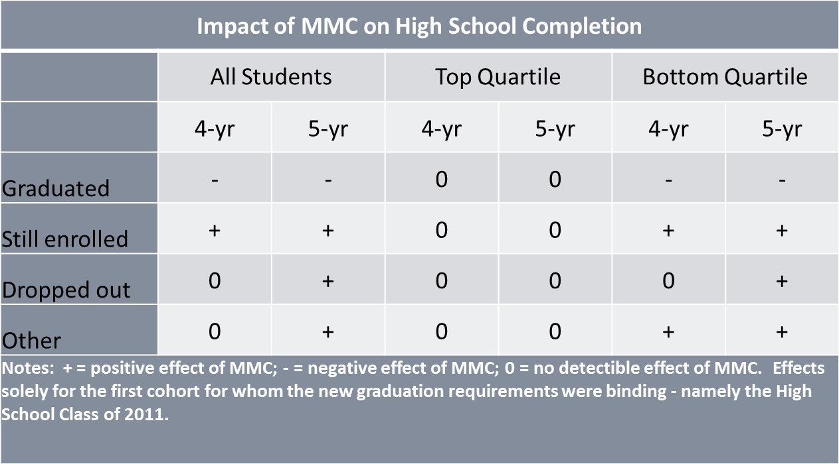
MMC and High School Completion:
Preliminary findings for first cohort

Slide 16
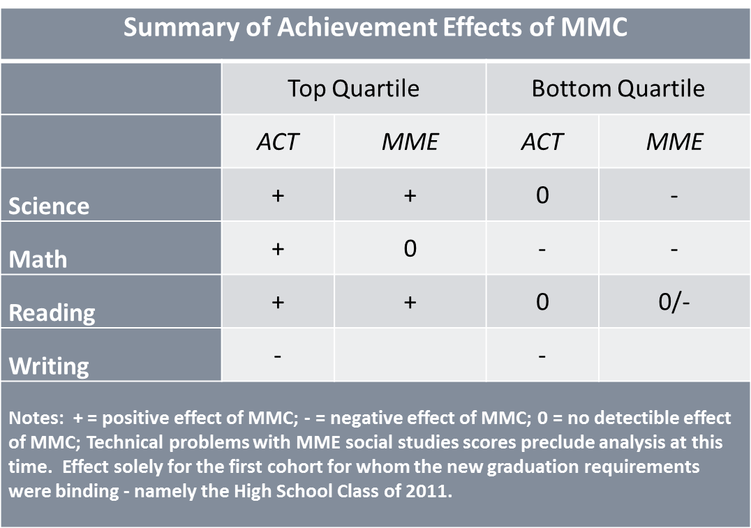
MMC and Test Scores:
Preliminary findings for first cohort

Slide 19
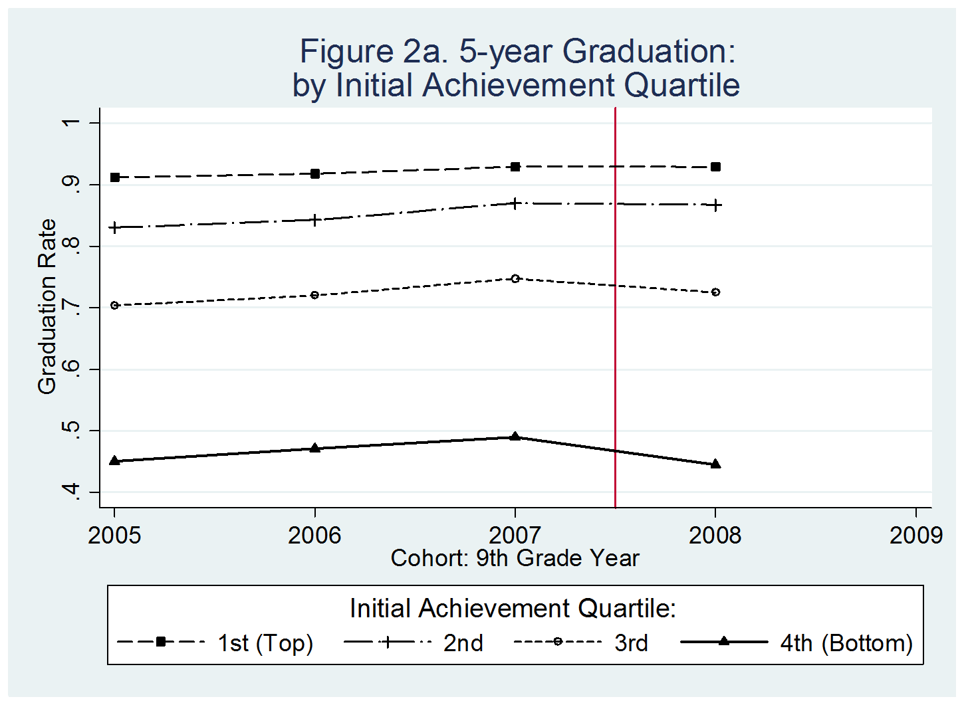

Slide 20
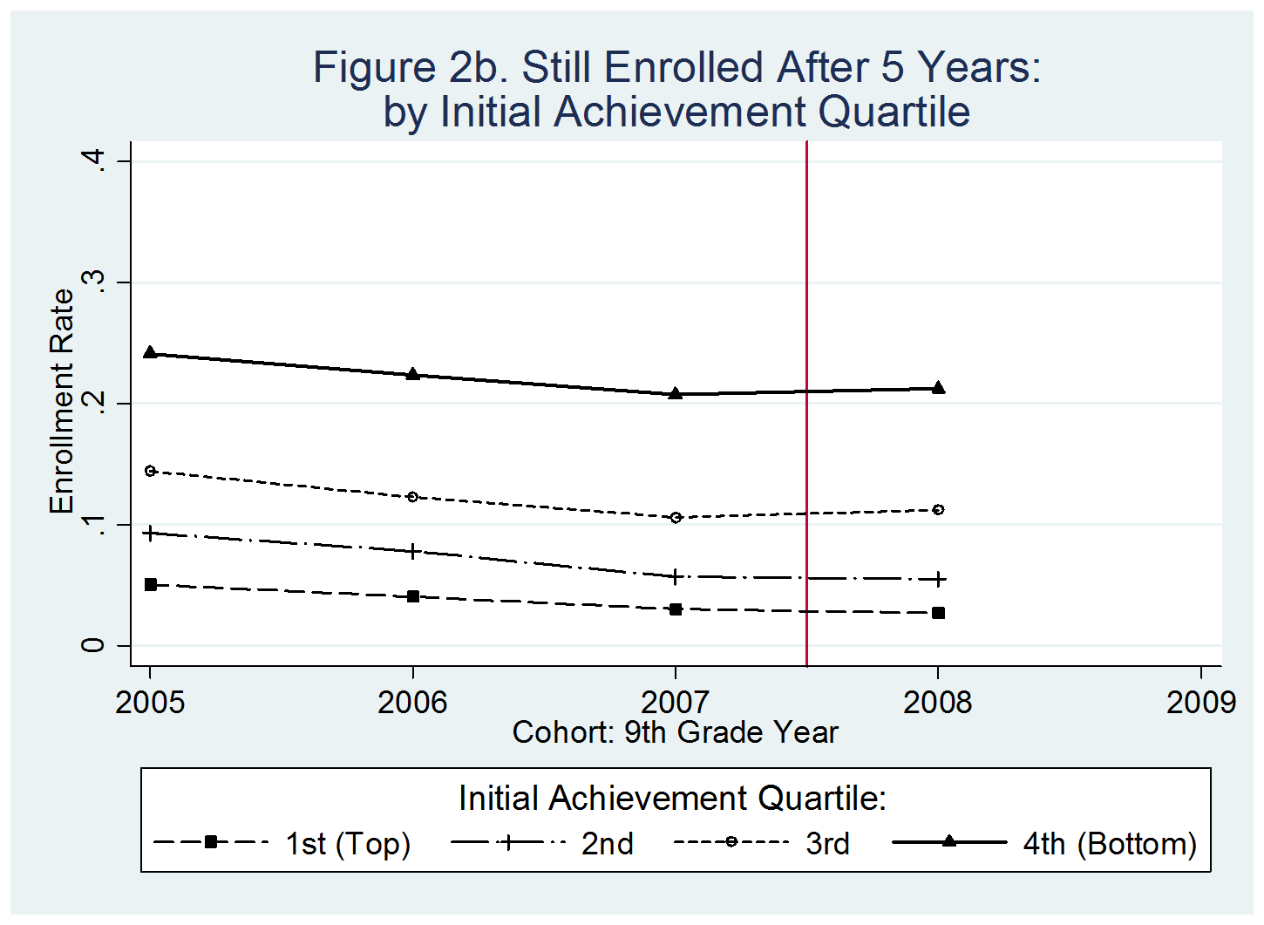

Slide 21
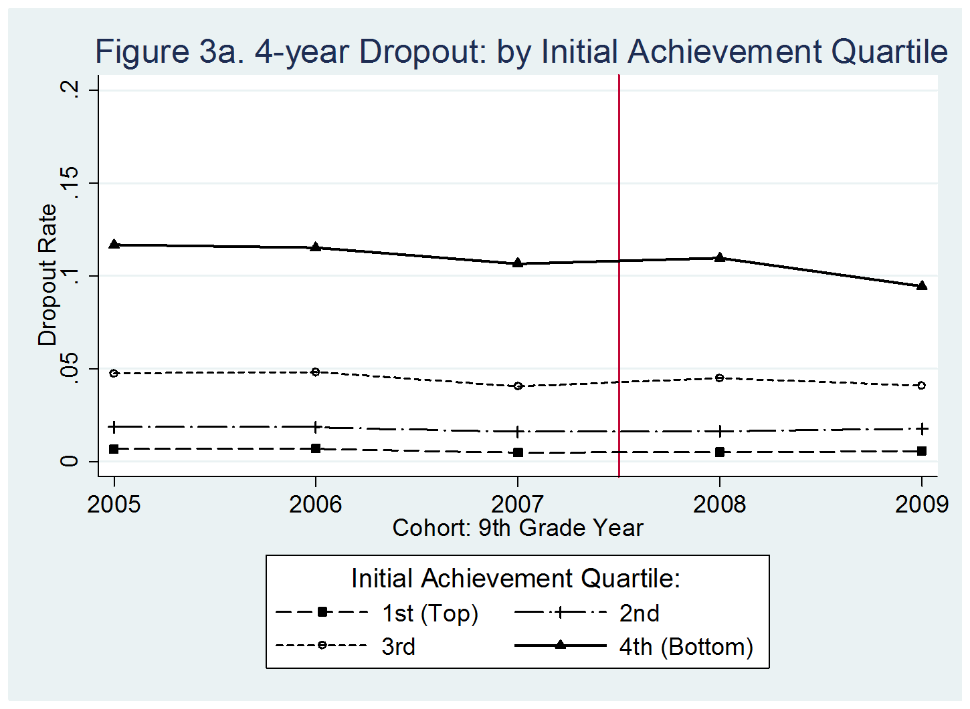

Slide 22
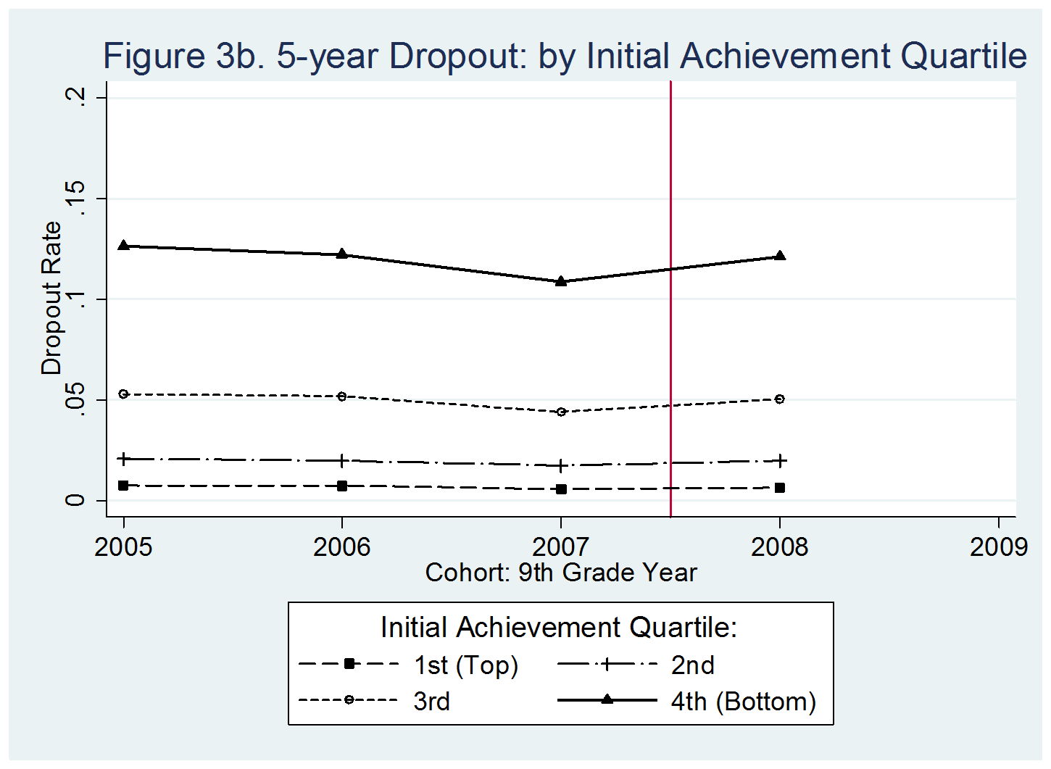

Slide 25
MMC and High School Completion:
Preliminary findings for first cohort

Slide 26
MMC and Test Scores:
Preliminary findings for first cohort

Slide 27
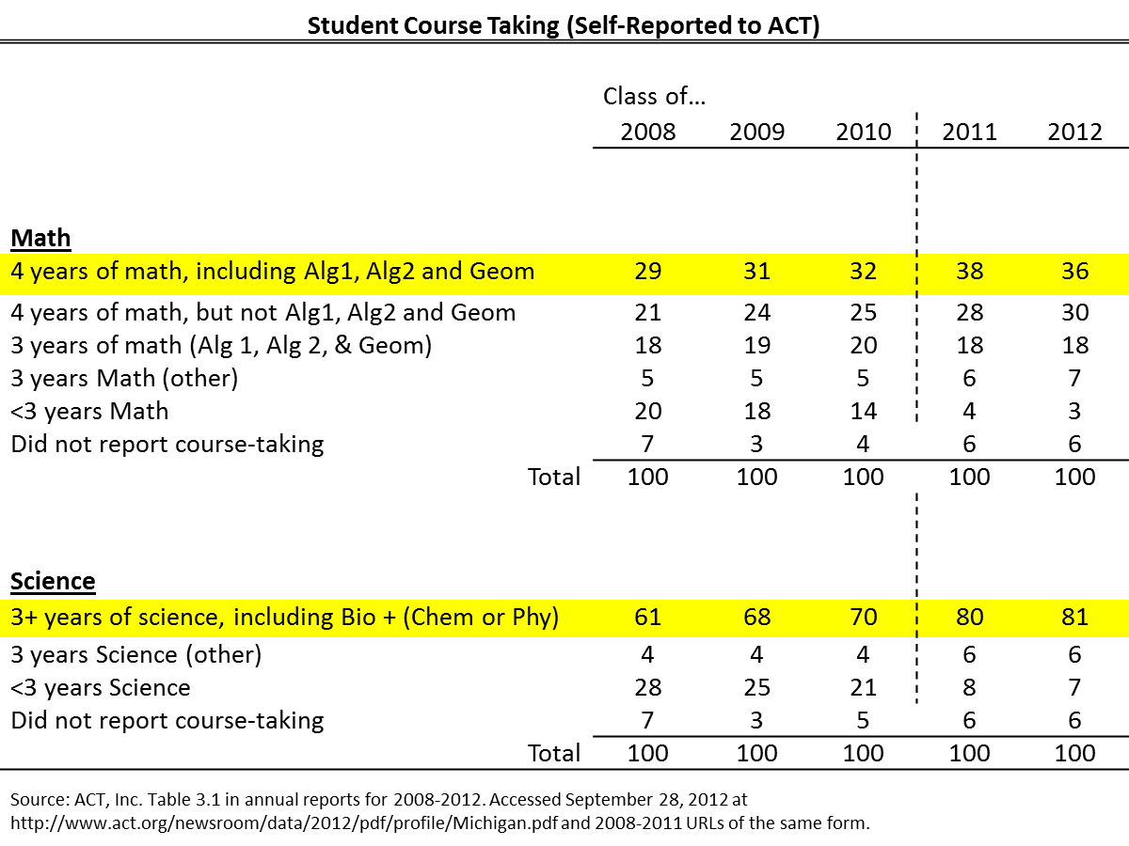
Changes in Course Taking?

Slide 28
Some Early Lessons
Importance of examining impacts separately by student preparation
  Additional supports for low-achievers?
  Are high-achievers really benefiting as much as we would hope and expect?
Potential slippage in implementation
  Will schools grow in ability to implement over time?
  Transcript study will shed more light on this issue
Variation in effects across subjects
  Some concerns: writing and other “non-MMC” subjects
  Some puzzles: math versus science
Broader implications
  Common Core will present a challenge for states
  Tension between flexibility and rigor

Slide 29
Thank You.
Questions?

Slide 30
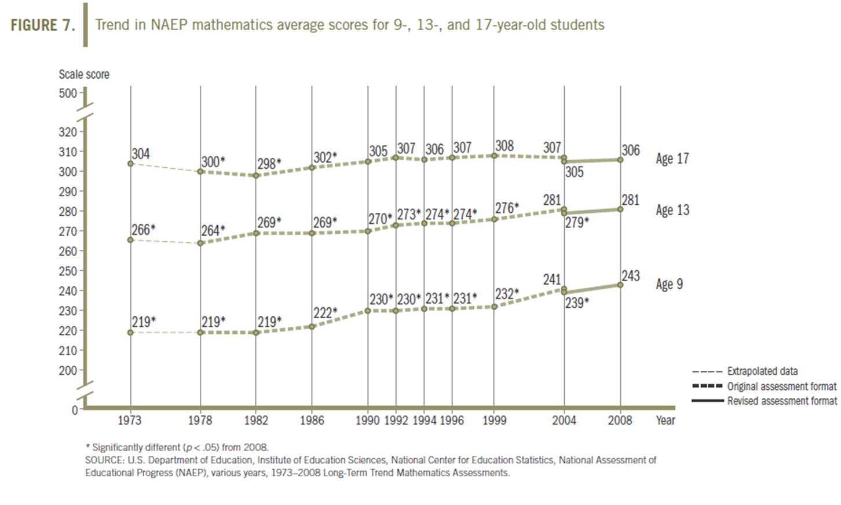
NAEP Math Trends, by Age

Slide 31
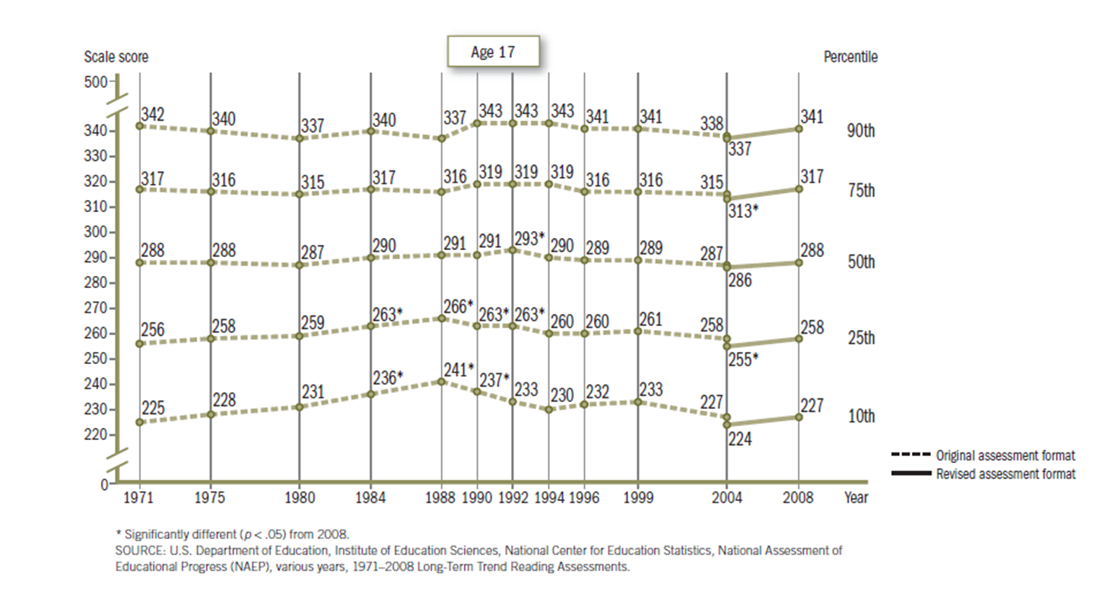
NAEP Reading Trends, 17-year-olds

Slide 32
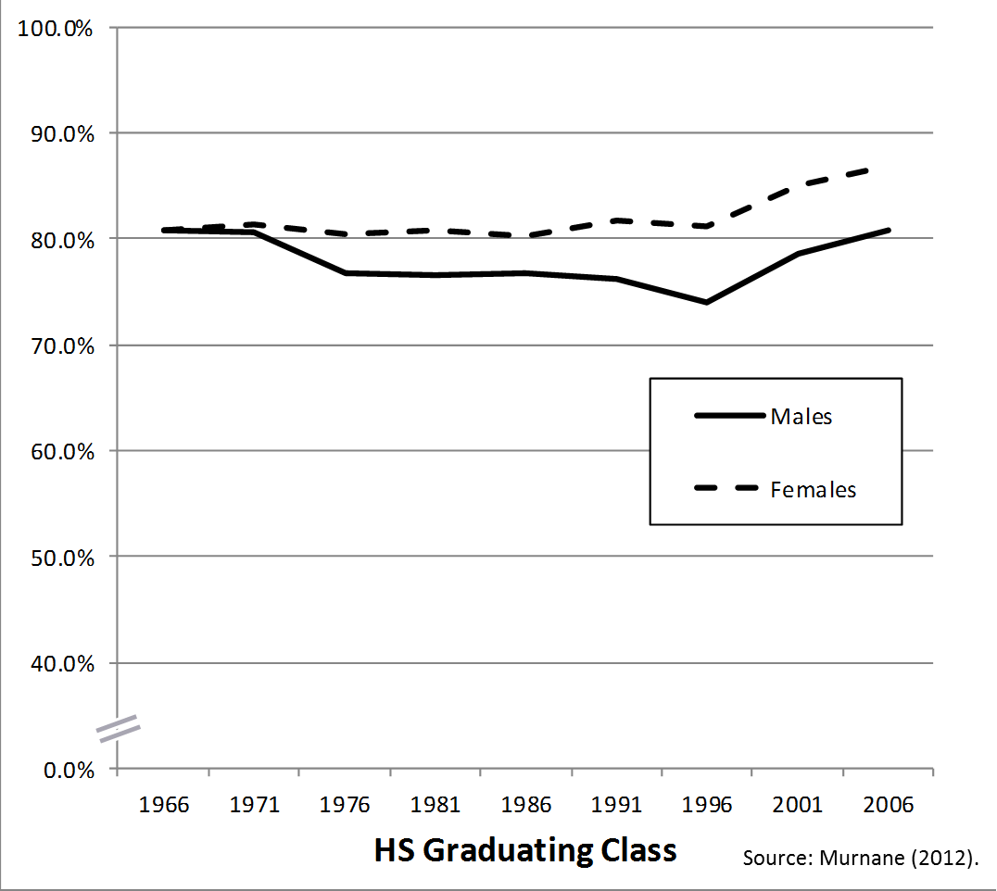
High School Graduation Trends

Slide 33
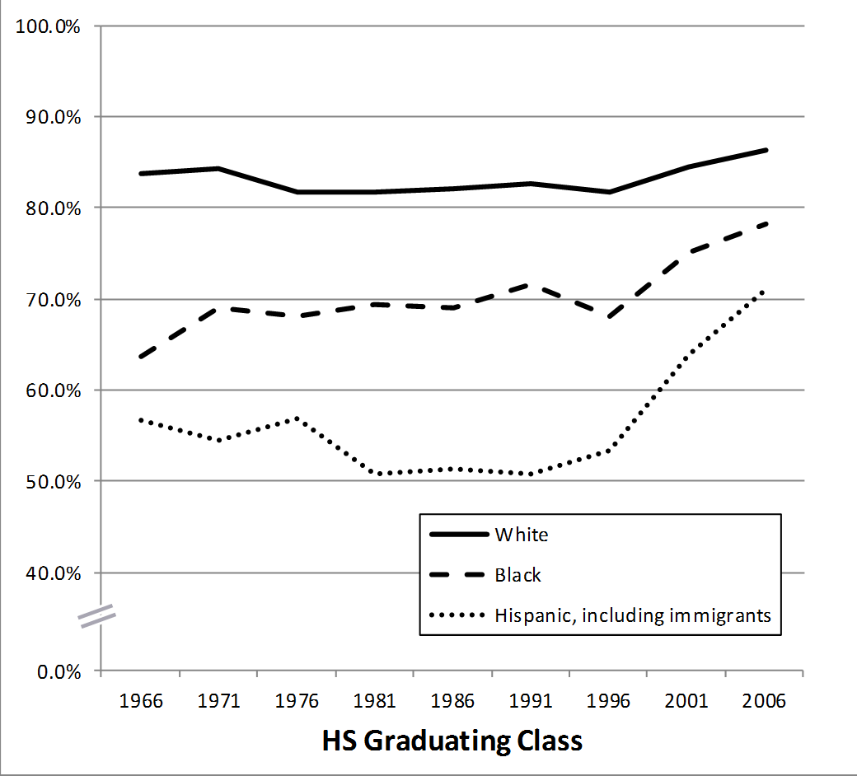
High School Graduation Trends

Slide 34
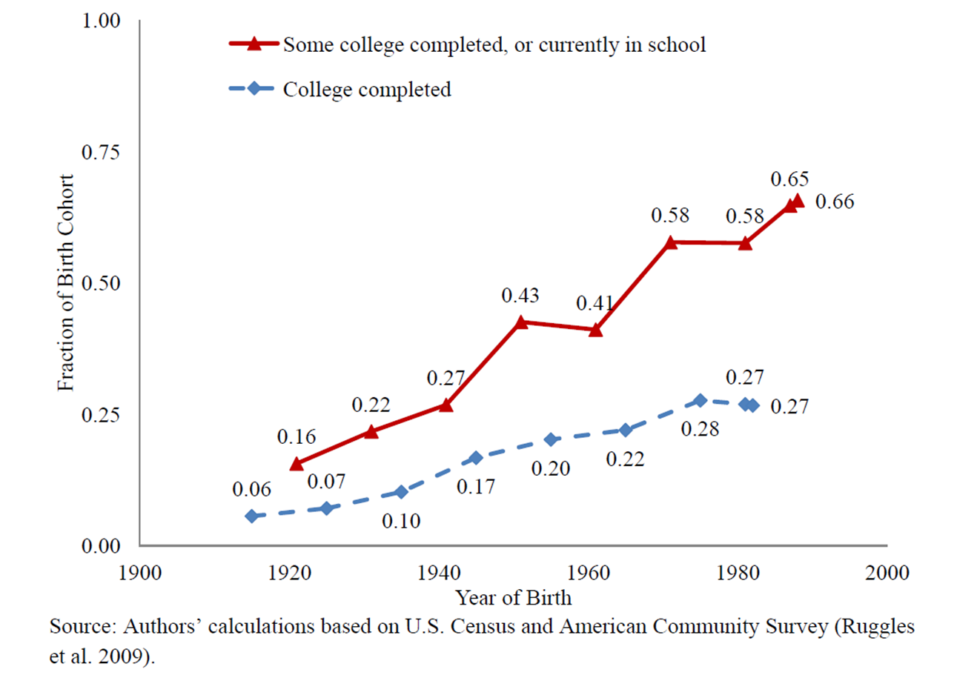
Trends in College Entry and Completion

Slide 35
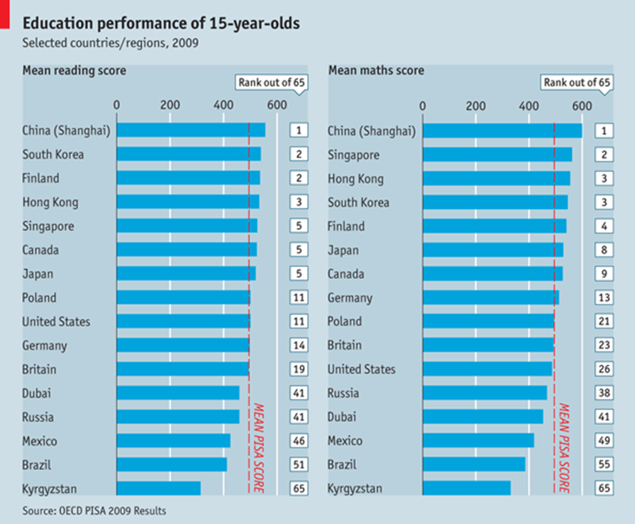
International Comparisons, 15-Year-Olds, 2009

Slide 36
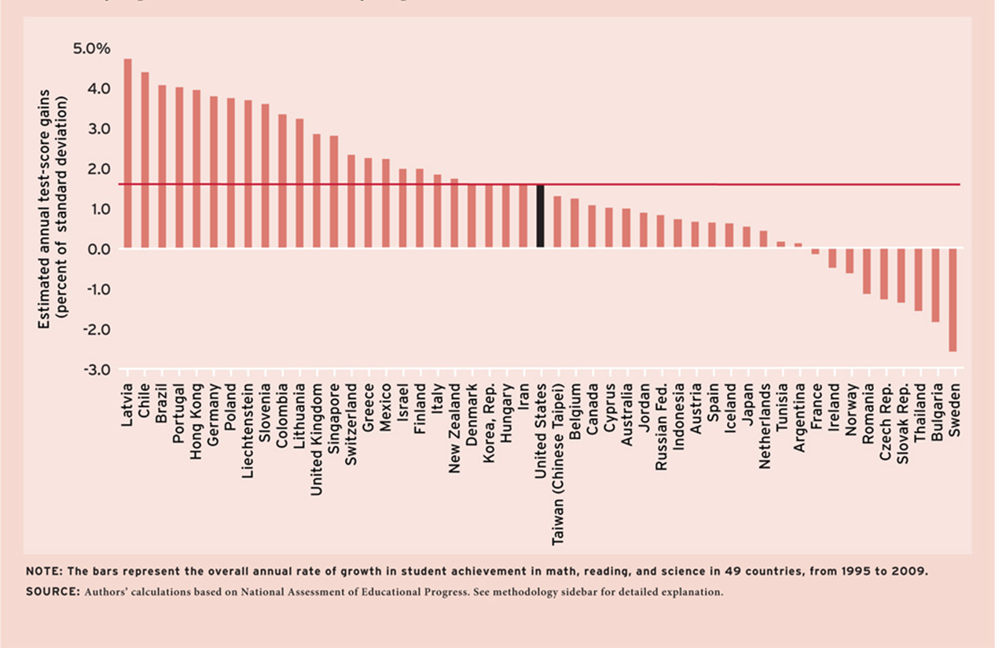
International Comparisons, 15-Year-Olds, Growth 1995 to 2009

Slide 37
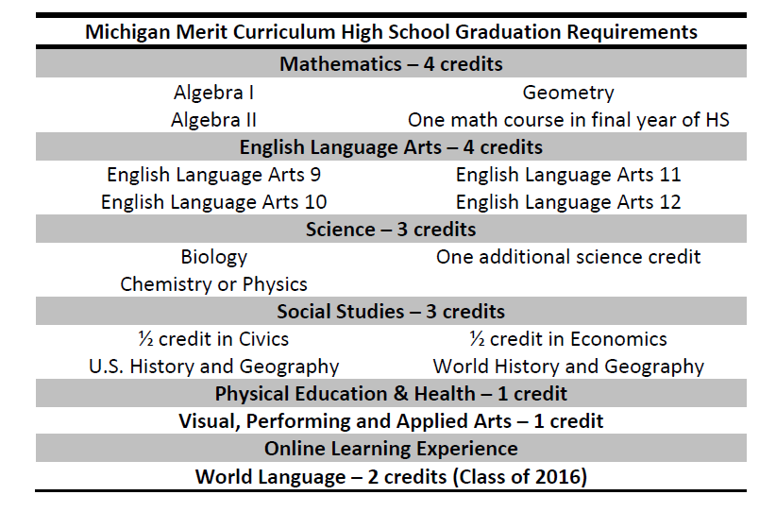

Slide 38
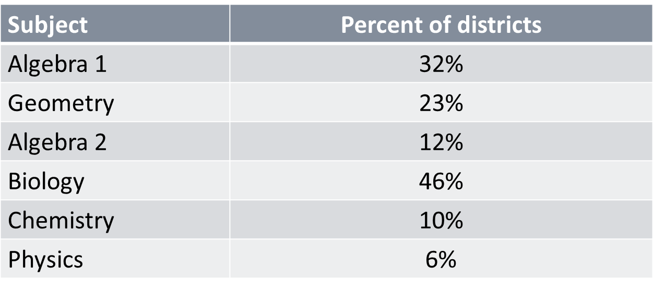
Michigan district-level graduation requirements in 2005

