Slide 1

The MMC and Teacher Composition

Slide 2
Main Questions
Have high schools reallocated teaching positions to meet curricular changes?
What has been the impact of the MMC on the balance of teachers?
  MMC vs. non-MMC

Slide 3
Table 1. High School Teachers in Michigan, 2004-2011
Year | # full-time HS teachers | # high-school students | student-teacher ratio
2004 | 19,390 | 355,961 | 18:1
2005 | 19,685 | 355,439 | 18:1
2006 | 19,571 | 358,591 | 18:1
2007 | 17,595 | 349,003 | 20:1
2008 | 17,552 | 341,565 | 19:1
2009 | 17,186 | 331,569 | 19:1
2010 | 15,990 | 320,998 | 20:1
2011 | 15,486 | 315,139 | 20:1

Slide 5
Number of Full-time HS teachers by MMC subject
Note: The Dotted line indicates announcement and the solid line indicates implementation of the MMC.

Slide 6
Student-Teacher Ratios for
MMC-only and Other Teachers
Note: The Dotted line indicates announcement and the solid line indicates implementation of the MMC.
.

Slide 7
Conclusions
After the MMC, schools became more focused on assignments for MMC-core teachers:
  MMC student/teacher ratios fell
  Non-MMC student/teacher ratios rose
Trade-off may be declines in school focus on non-MMC core subjects.

Slide 8
Economic Conditions in Michigan,
2000-2010

Slide 9
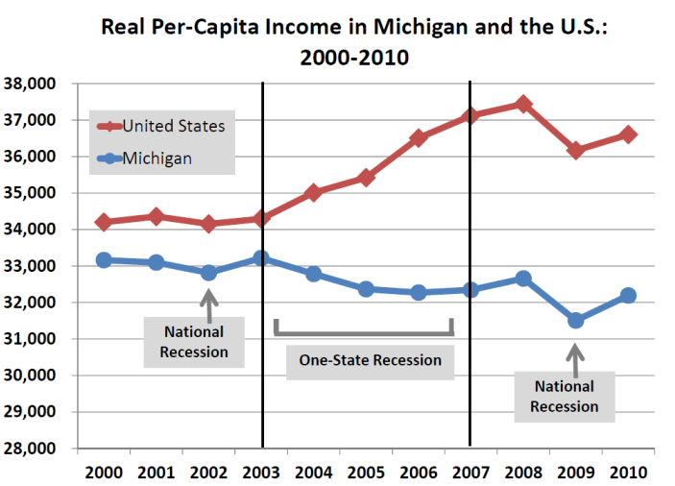
One State Recession
Source: “Real Per-Capita Personal Income in Michigan and the U.S.:2000-2010” by the Michigan Department of Technology, Management, & Budget

